Slide 1
Sensing Technologies for Data Collection and Monitoring
Pat Pannuto
University of Michigan
DIL ‘14 – State of the Science

Slide 2

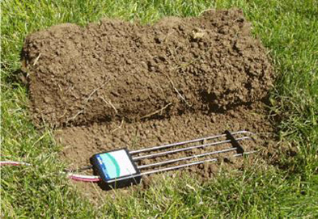
Data is empowering
[UFL BuildGreen]
[GLACE Team Rainfall Estimation]

Slide 3
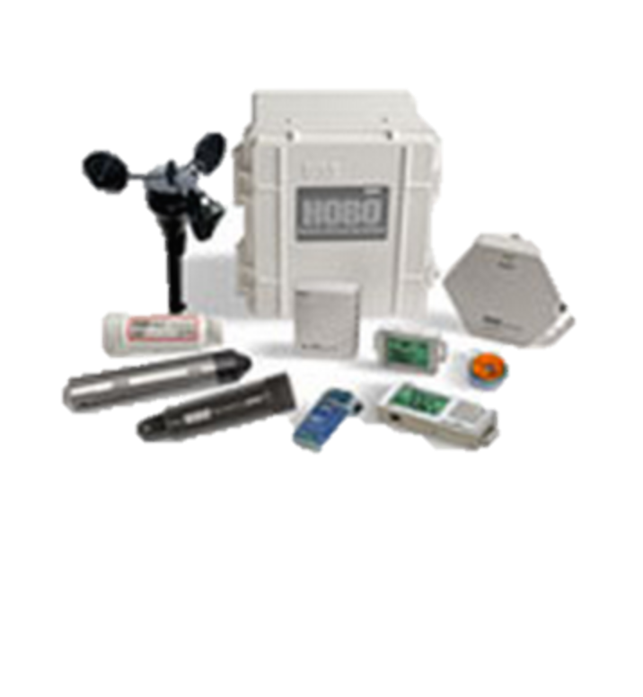
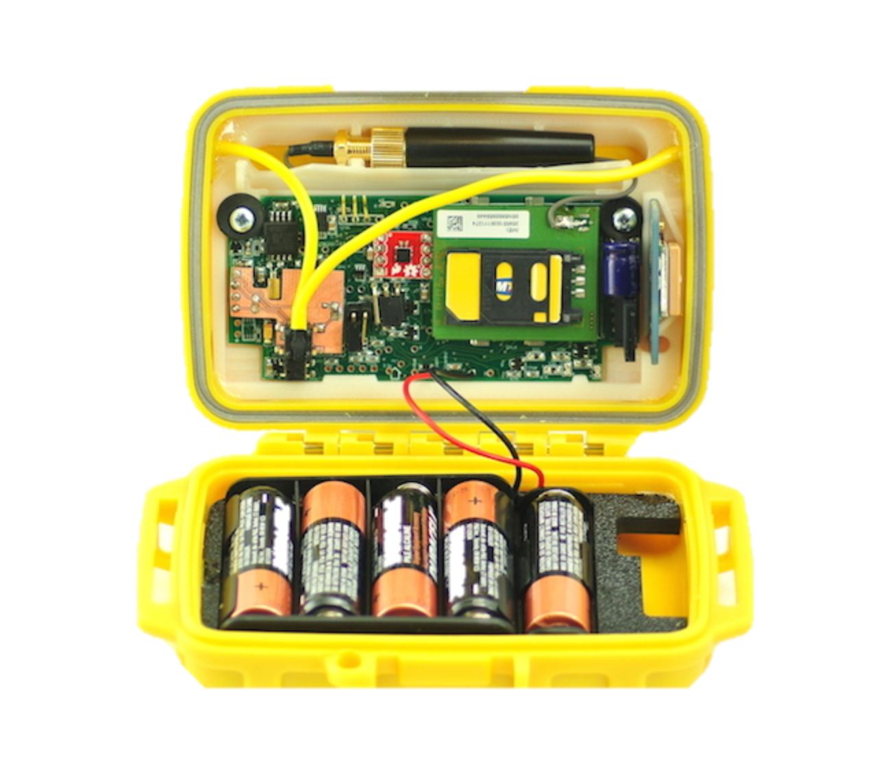
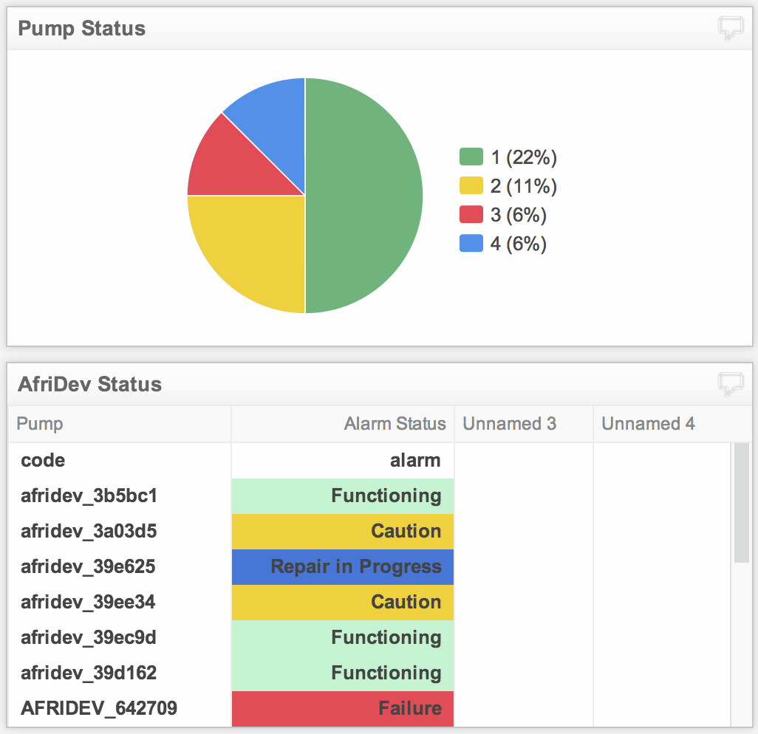
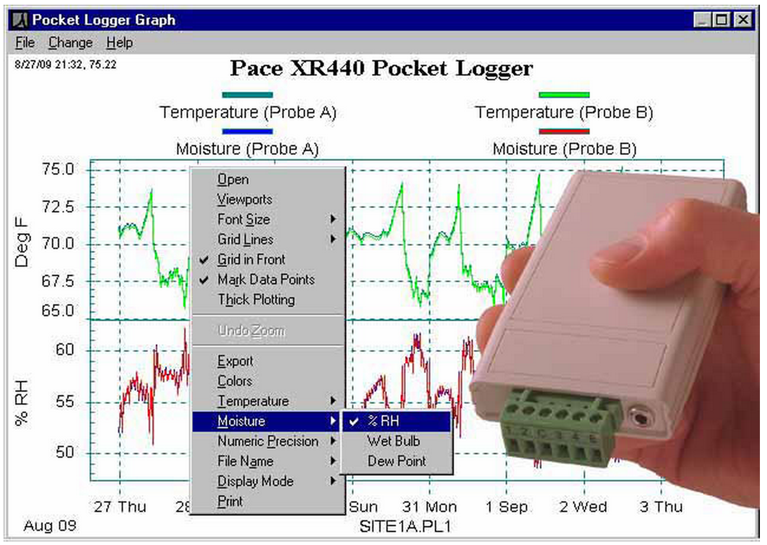

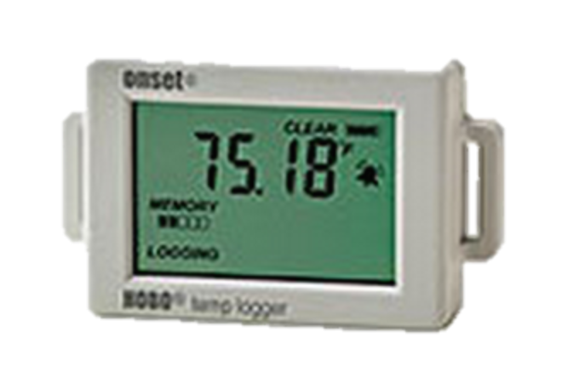
Where does data come from?
Sensors
Used to get data from the physical world to the digital world
Automated, continuous data collectors
[SweetSense]

Slide 4
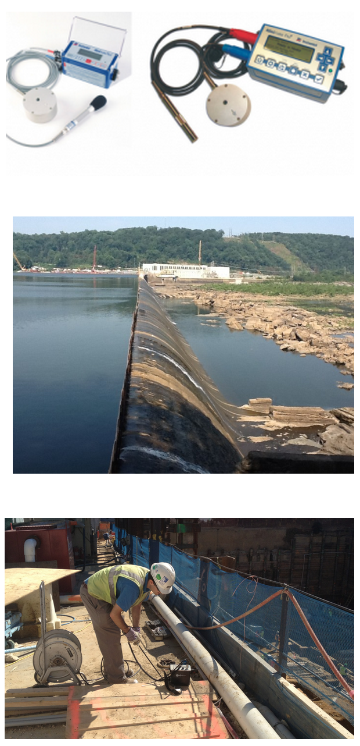
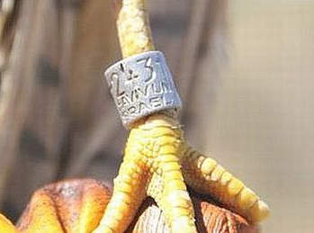
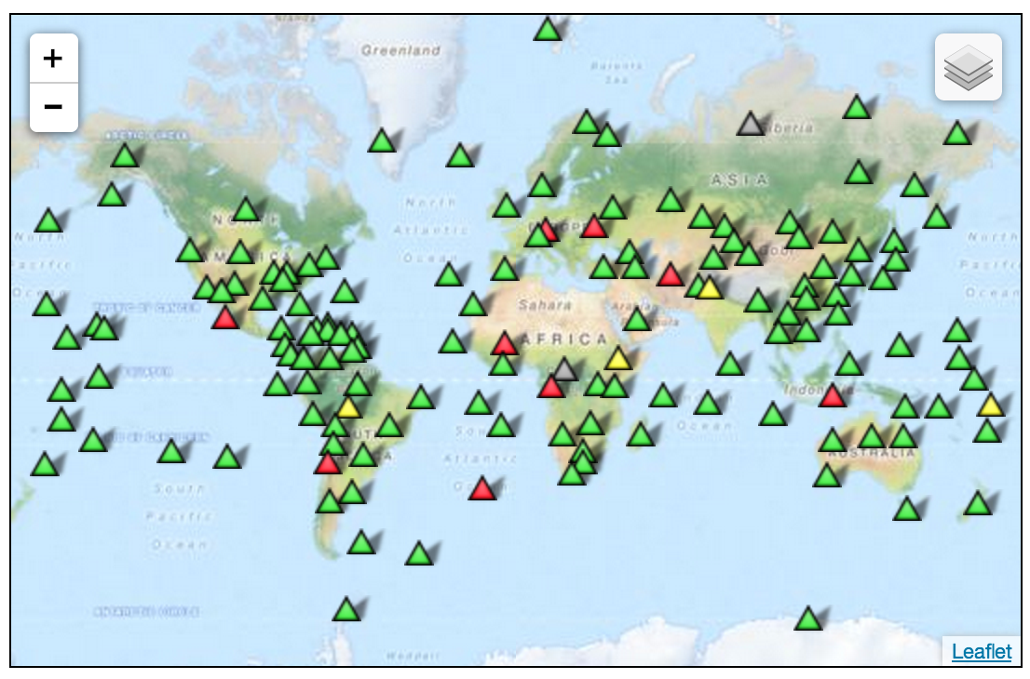
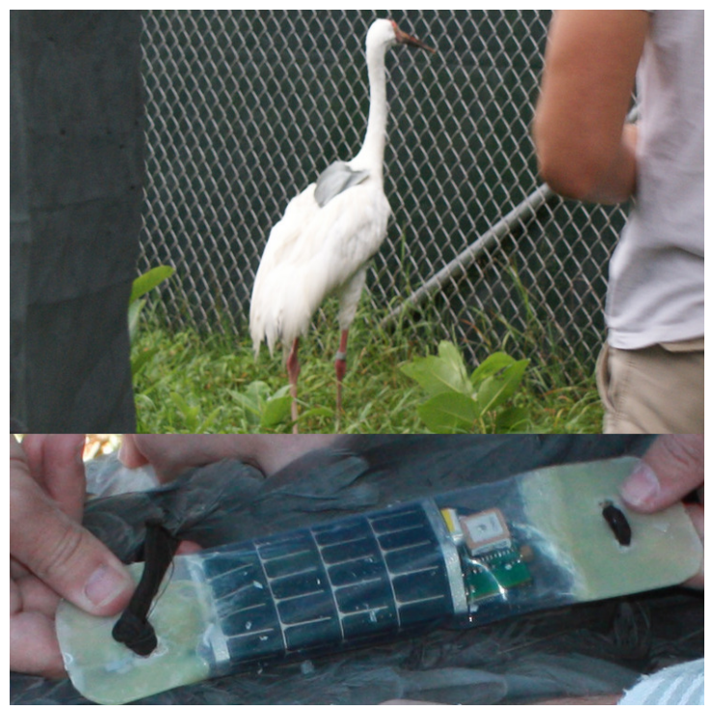
The most important question in planning your deployment, part 1
How often do I need to get data from my sensors?
[Global Seismographic Network]
[Seismic Surveys]
[Bennet: Crane Charades]
Real-time
Periodic
Single Dump

Slide 5
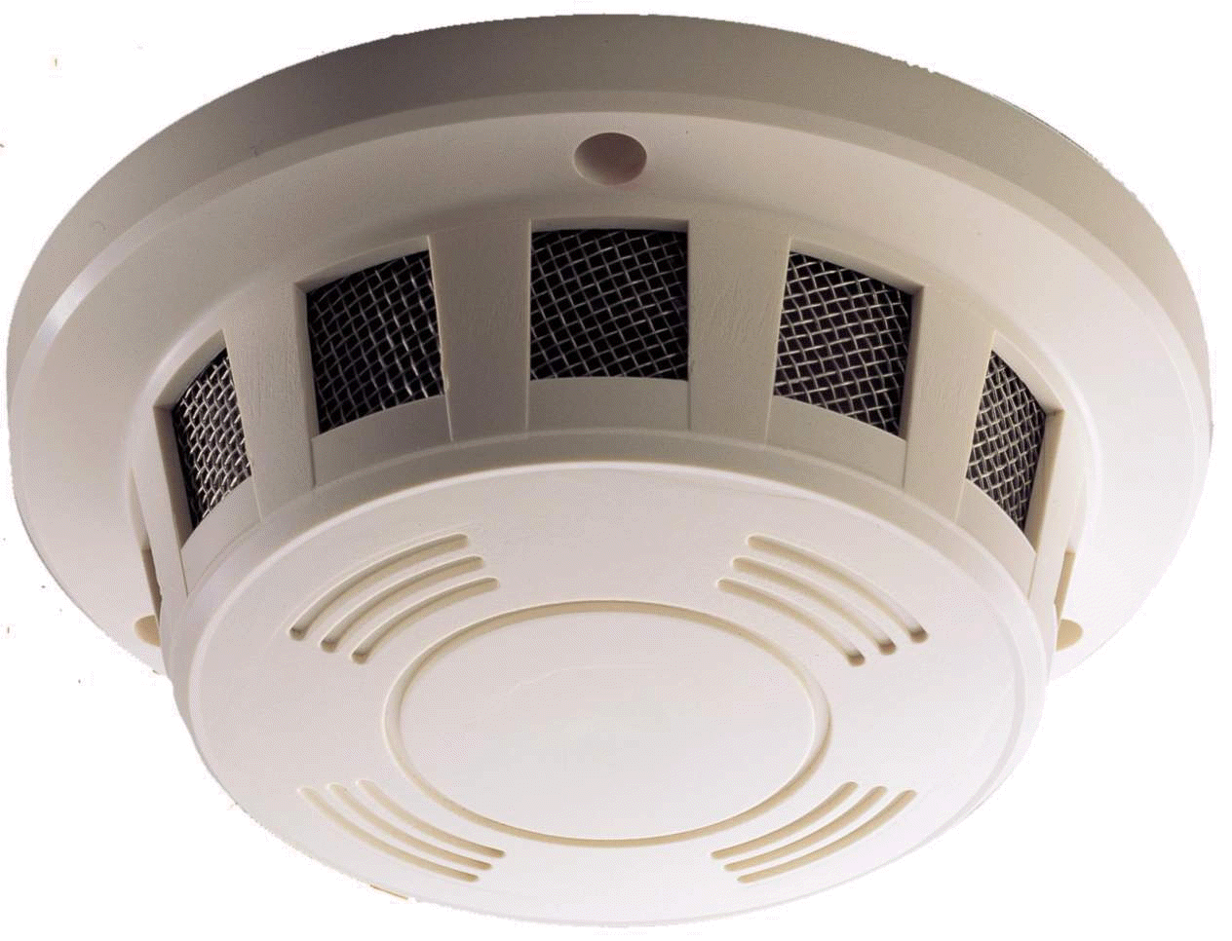
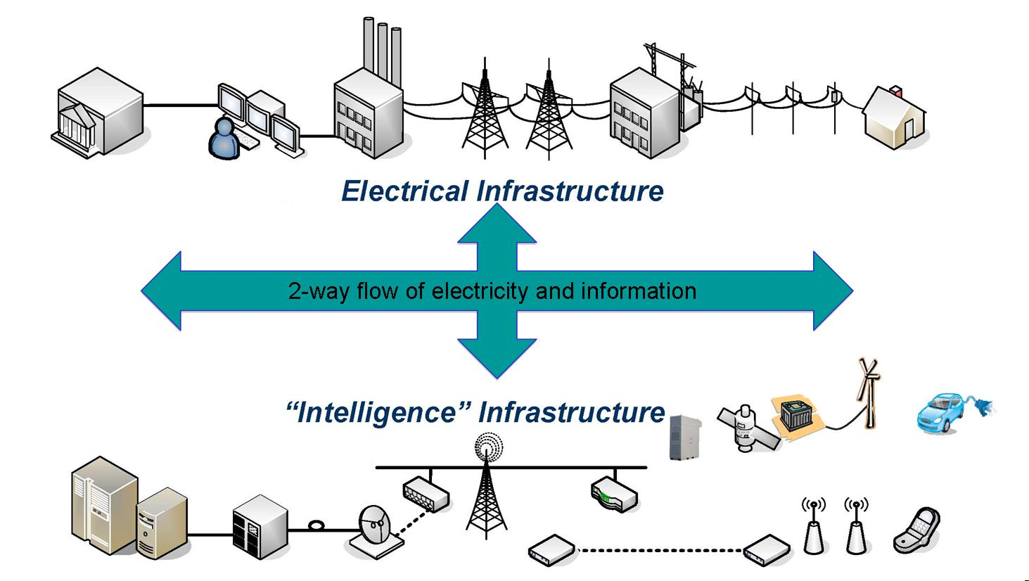
How am I going to get data off of my sensors?

Slide 6
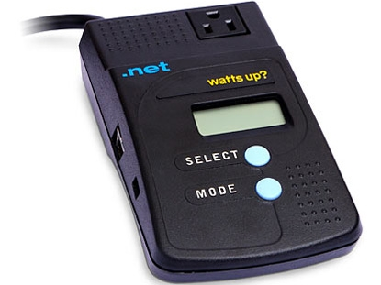
All forms of communication are not created equal

Slide 7
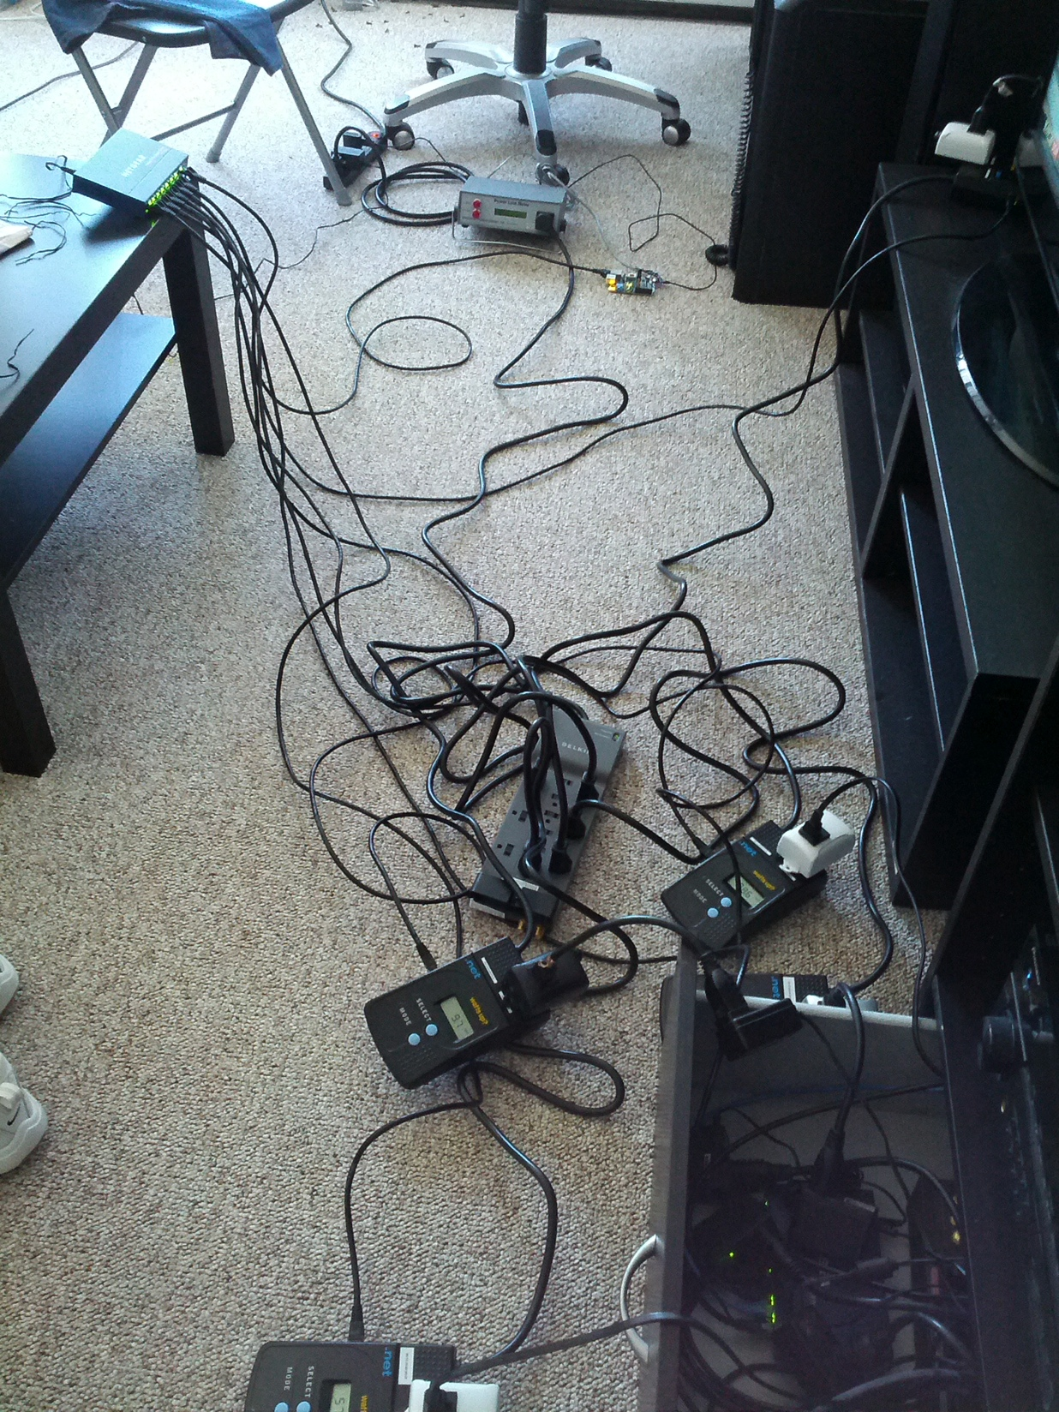
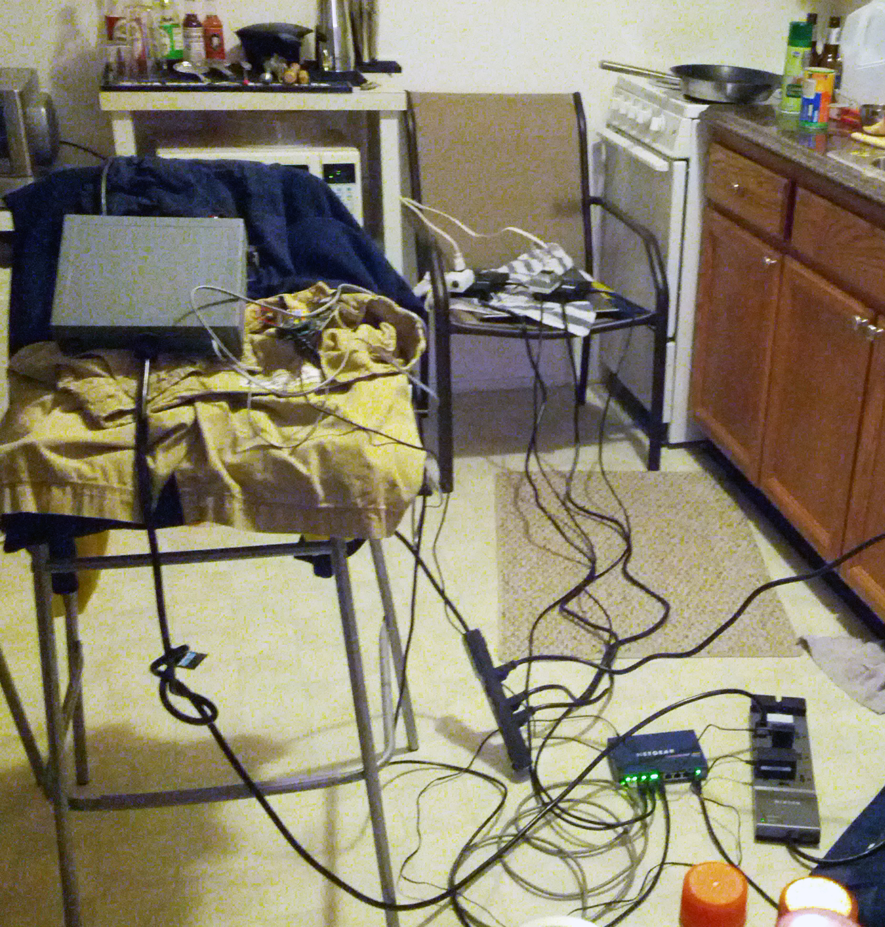
Instrumenting a home with WattsUp.net
Infrastructure

Slide 8
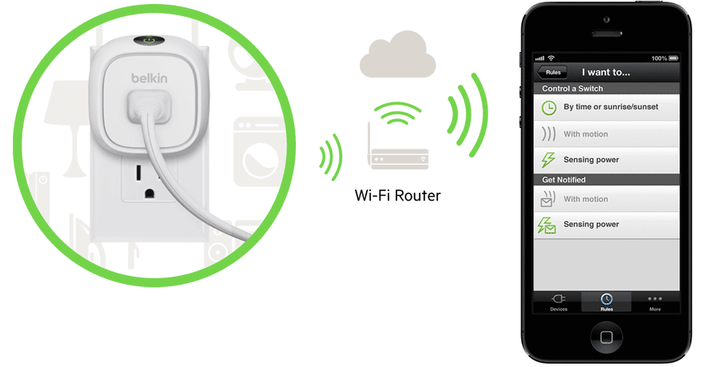
Going wireless does not eliminate infrastructure costs, it only shifts it
Hidden Infrastructure

Slide 9
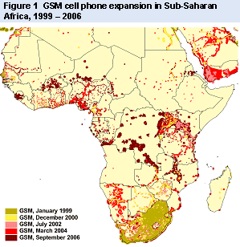
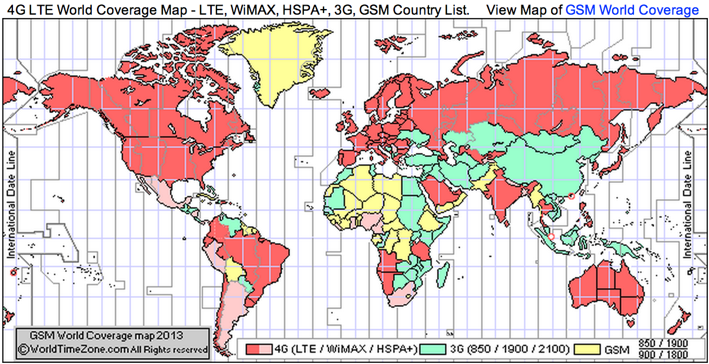
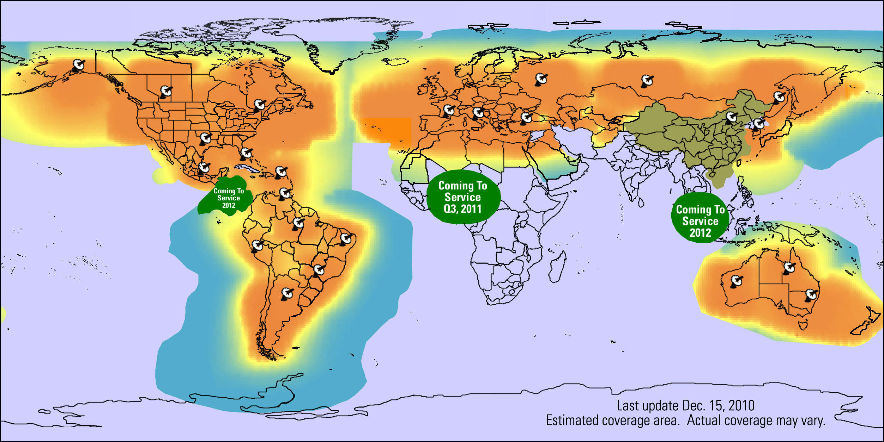
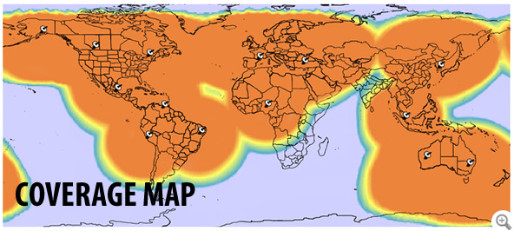
There is no truly ubiquitous communications infrastracture
[world bank]
[worldtimezone.com]
[satphonestore.com coverage, 2010]
[satphonestore.com coverage, 2011]

Slide 10
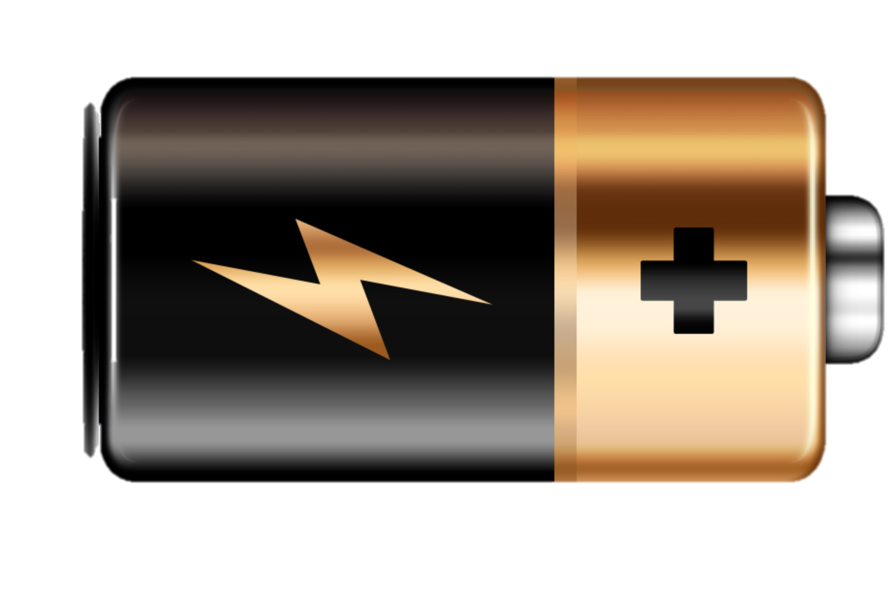
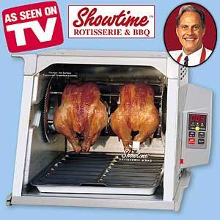
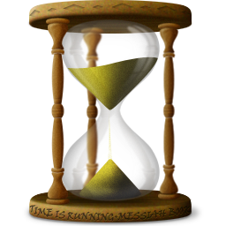
The next question: How am I going to power my sensor?
Informed by the previous questions
Batch Offloading is easy:
Battery size proportional to data size
Wired networks:
Relative cost of adding power wires is low (usually)
Wireless…

Slide 11

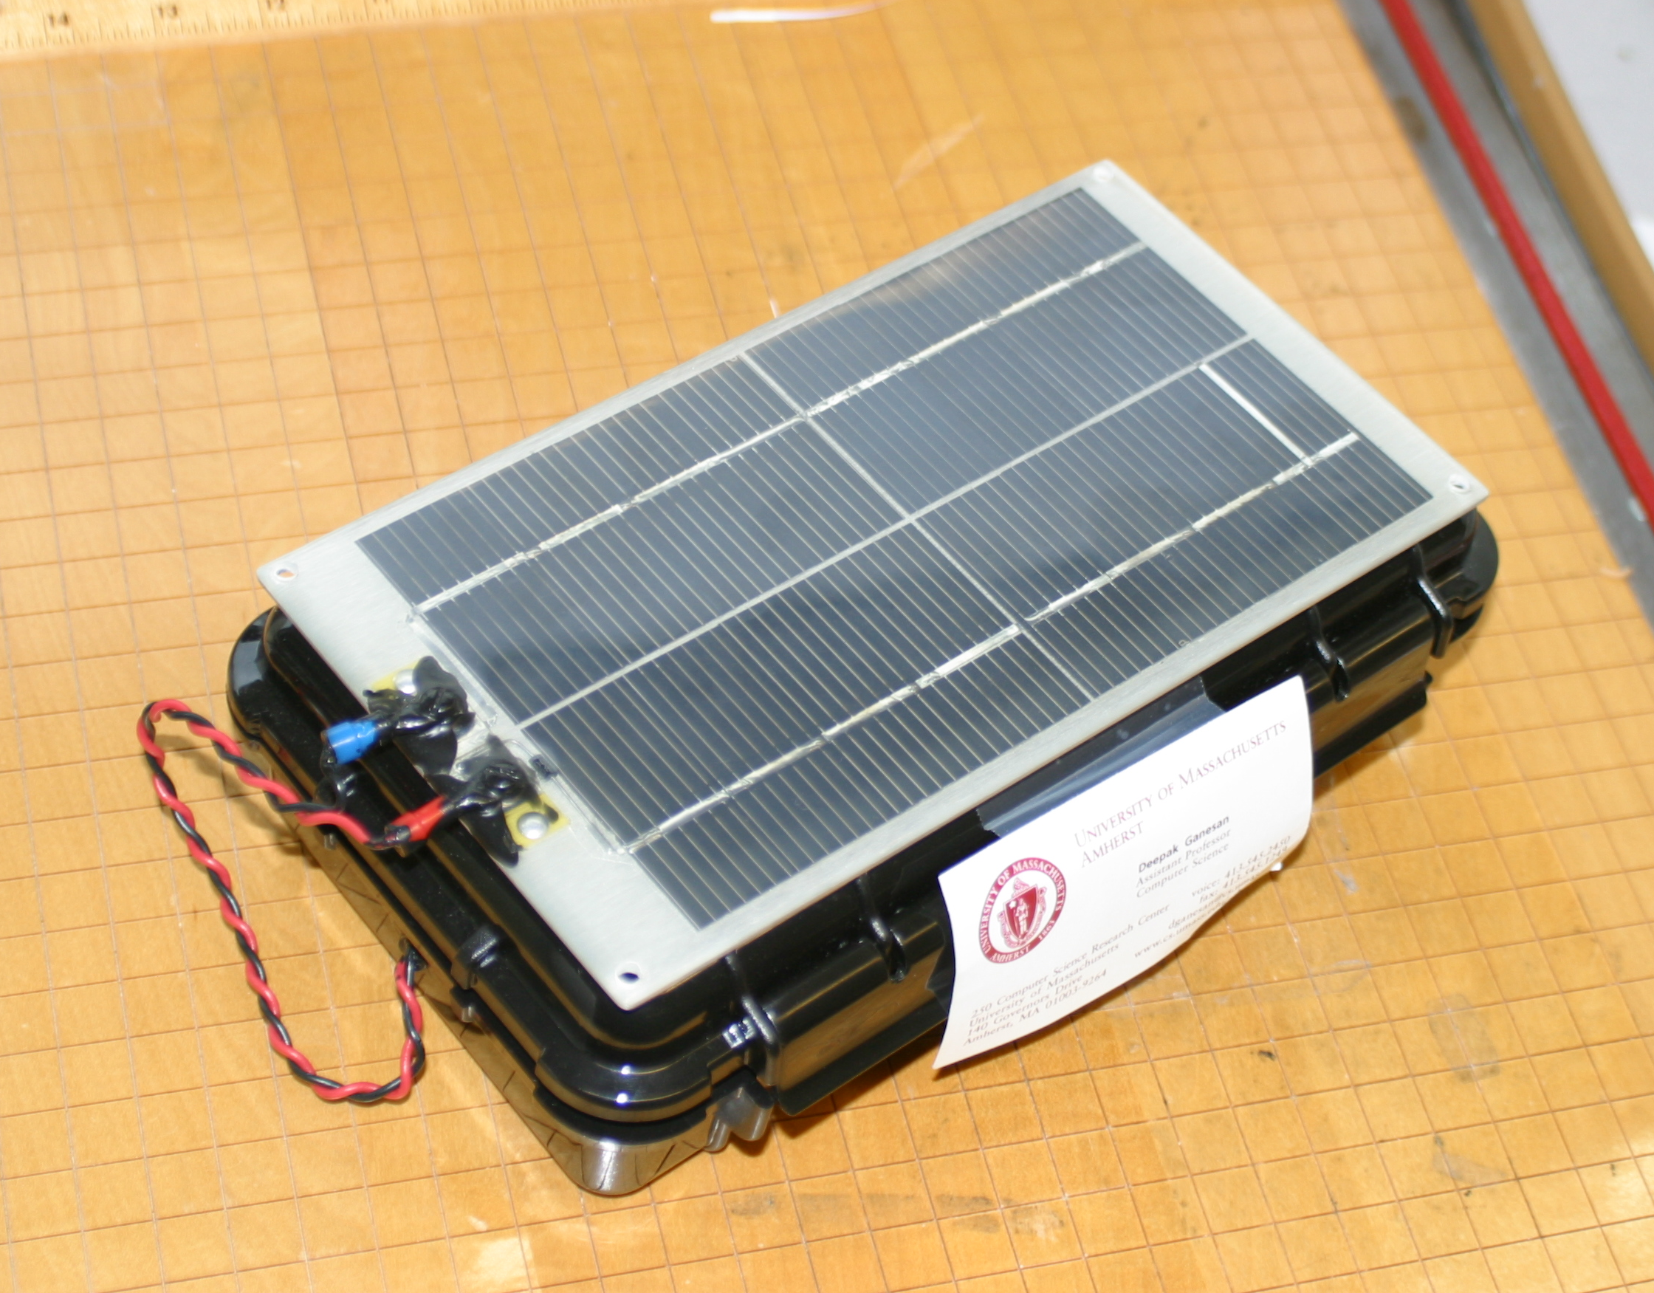

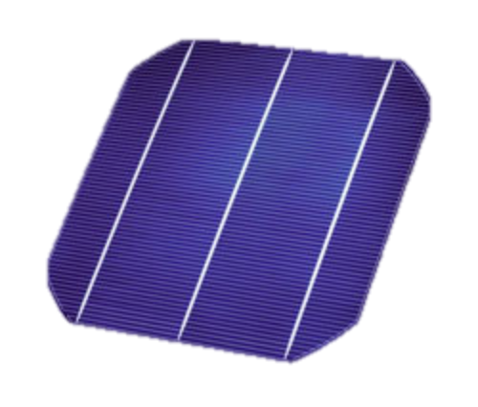
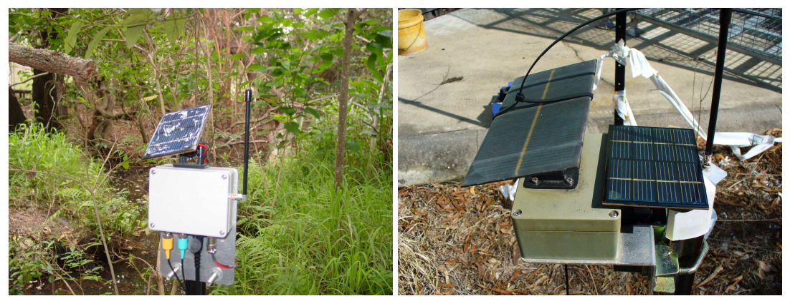
Idea: Do we need a battery?
[UMass Rivernet]
[CSIRO Fleck1]

Slide 12
Up until now, we have discussed “Traditional Sensing”
To sense temperature, use a temperature sensor

Slide 13
Systems goals do not necessarily map directly to sensing goals
“I need a sensor that measures water flow”
Mechanically challenging
“It needs to be wireless and last for several months”
“I want to measure if people wash their hands after they use the toilet”
You actually want a temperature sensor
Paul Martin, Zainul Charbiwala, Mani B. Srivastava
DoubleDip: leveraging thermoelectric harvesting for low power monitoring of sporadic water use
In Sensys’10

Slide 14
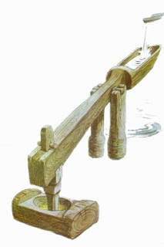
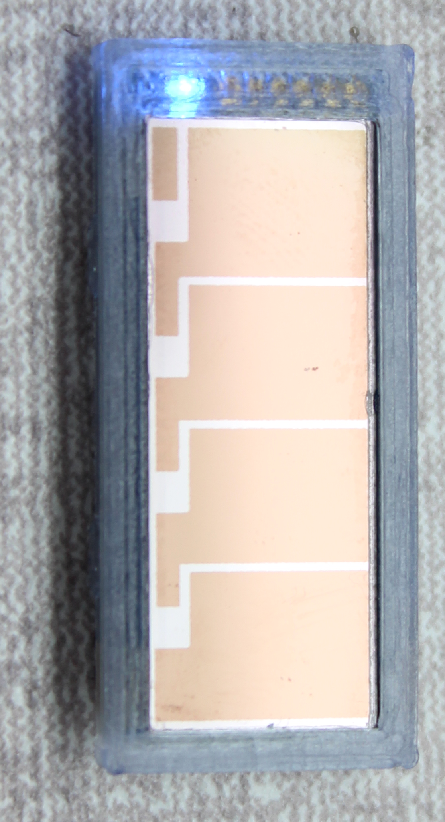
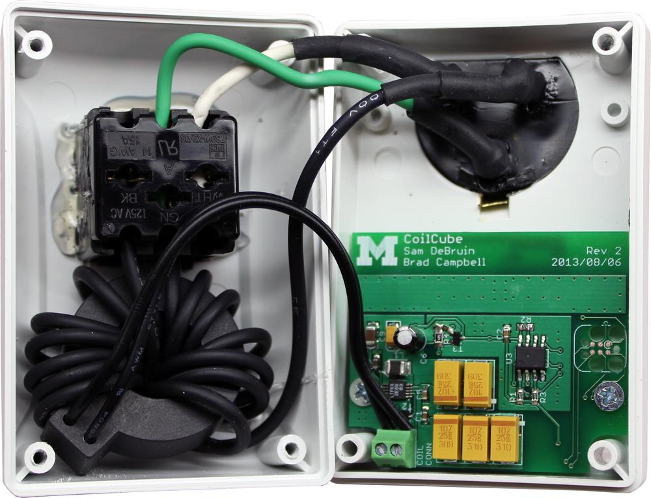
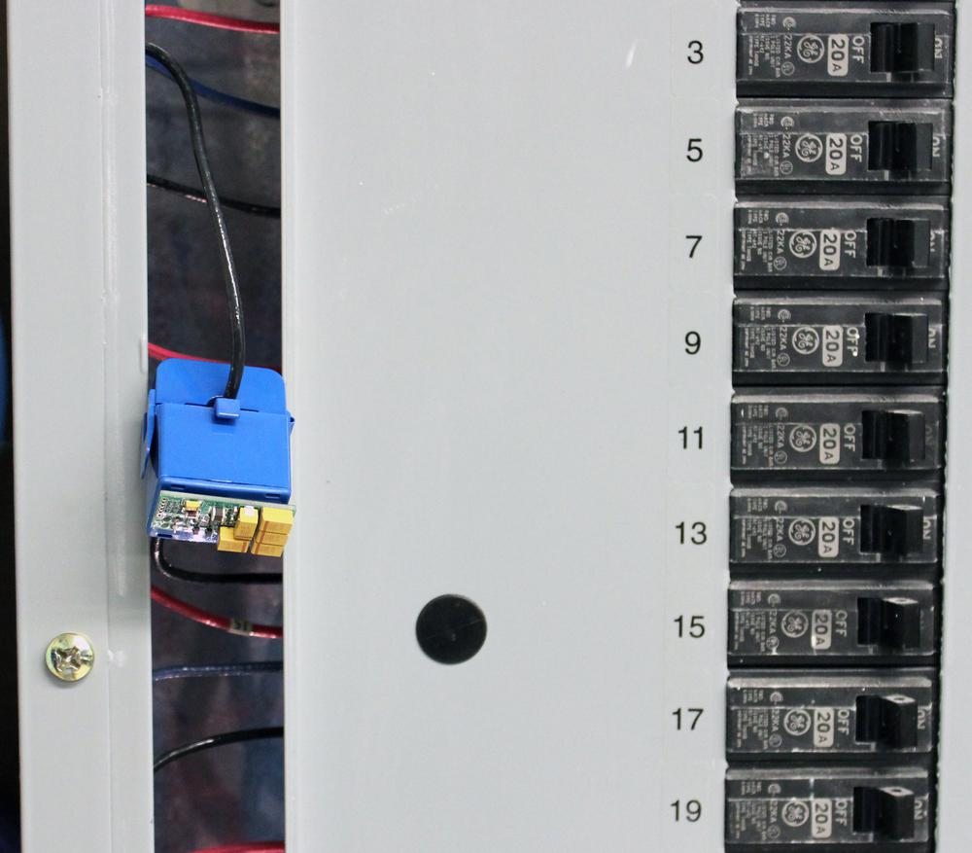
The Monjolo Principle Combining non-traditional sensing and energy harvesting
Harvest side-channels of energy – wakeup frequency is the sensor
[Monjolo, Sensys ‘13]

Slide 15

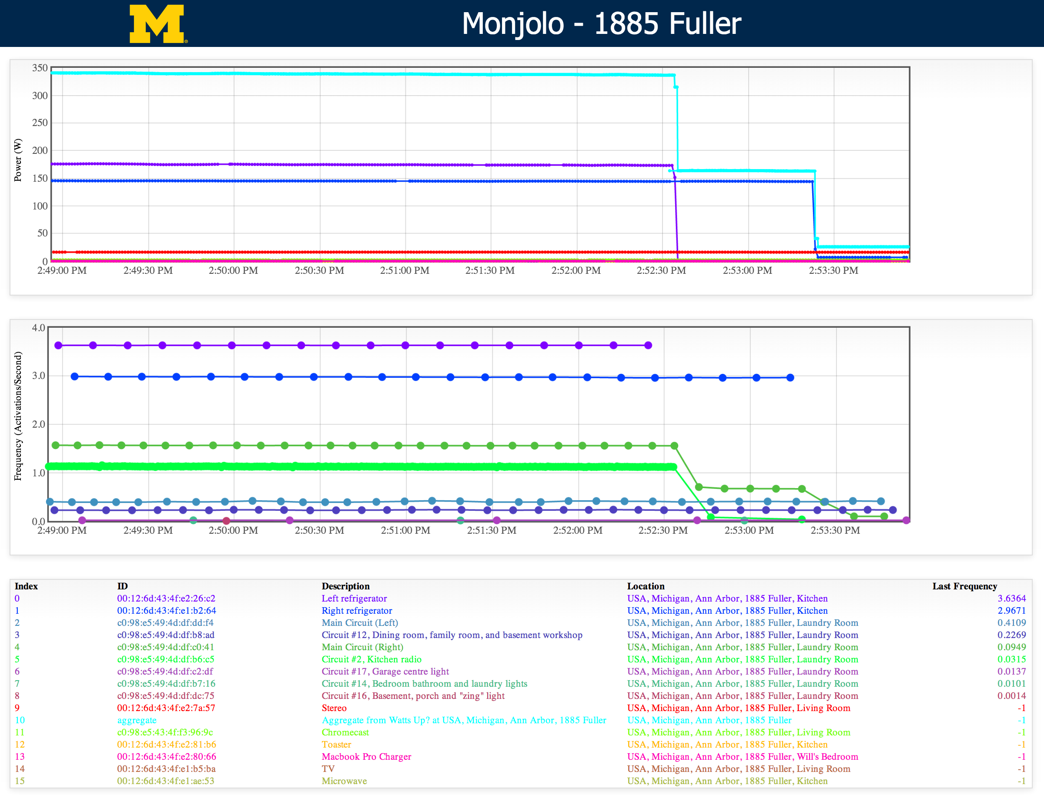
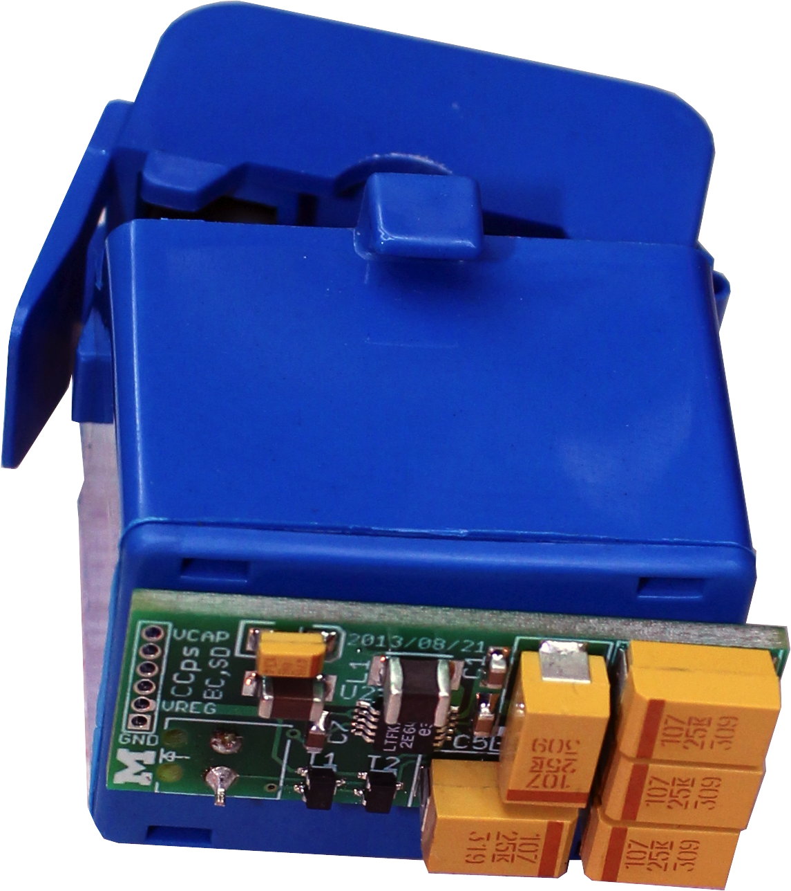
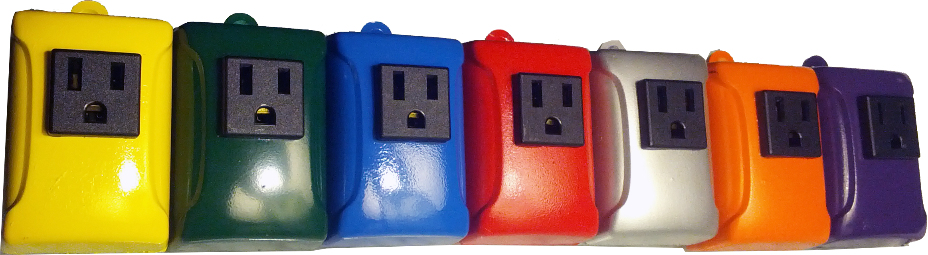
Monjolo in action
http://inductor.eecs.umich.edu/pathouse.html

Slide 16
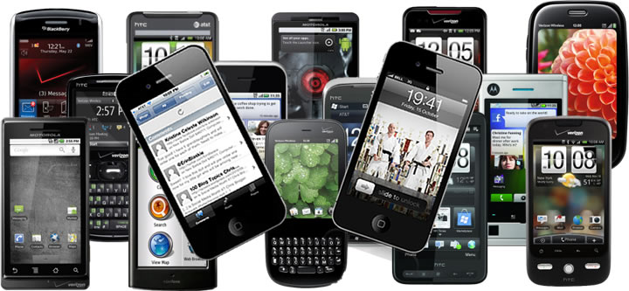
I have neglected the most deployed sensor in the world…
The Smartphone!

Slide 17
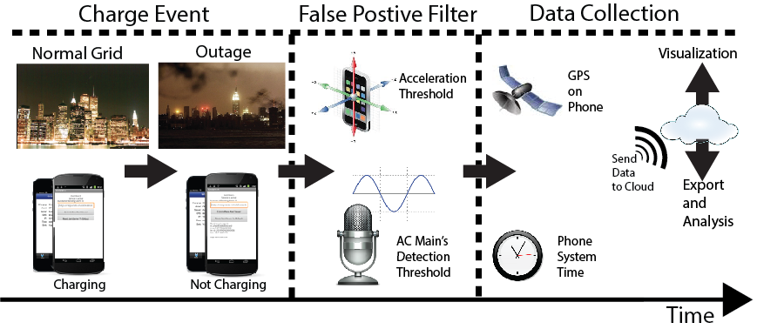
GridWatch: Crowdsourcing power grid health monitoring
Insight: You pick up your phone to unplug it
Power loss without motion is likely a power outage
[GridWatch HotMobile ‘14]

Slide 18
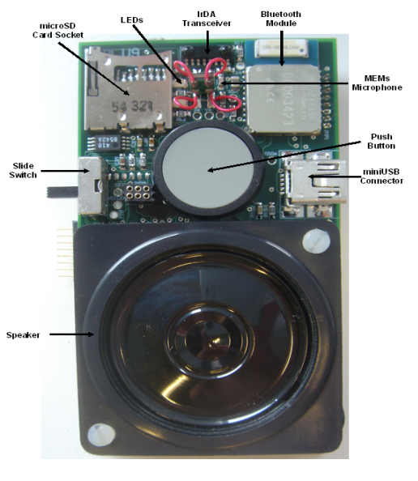
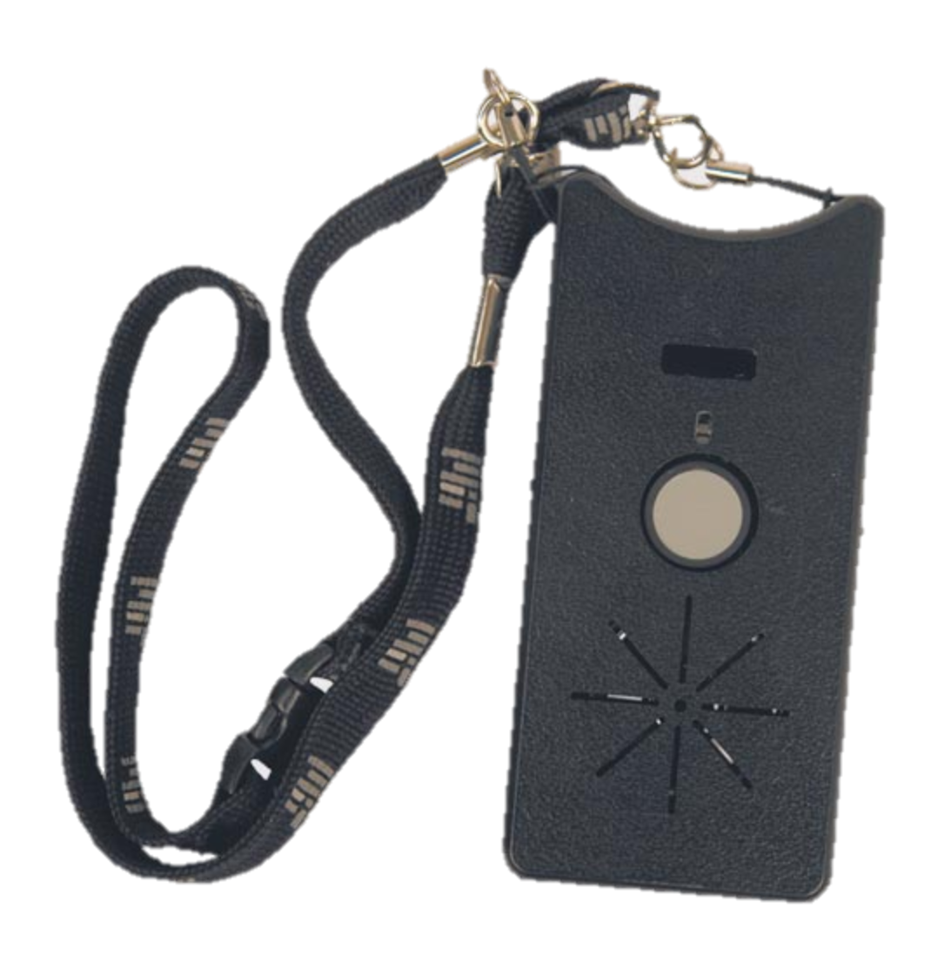
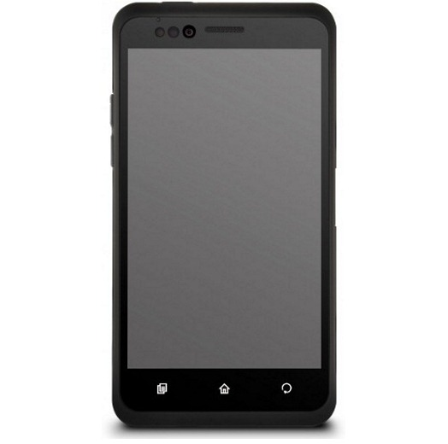
Smartphones have a diverse array of powerful sensors
Accelerometer, Gyroscope, Magnetometer, GPS, camera, …
And communication (cellular, WiFi, Bluetooth, NFC) is built in
Pentland ‘06
Pentland ‘07
Pentland ‘09

Slide 19
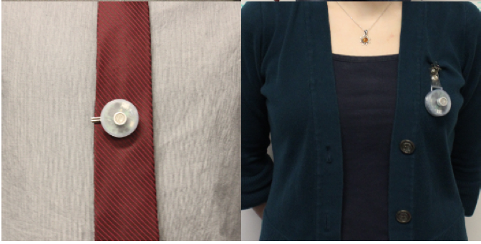
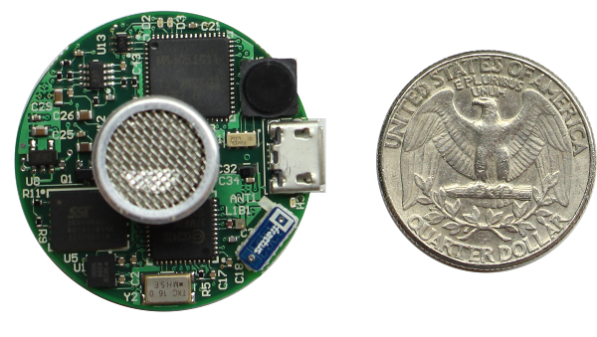
Why do people still build hardware if smartphones exist?
Cost
Don’t need a $100 smartphone to do the job of a $1 compass
Performance
Does this matter? Maybe.
Availability of sensors
…
[Opo: Pre-publication]

Slide 20
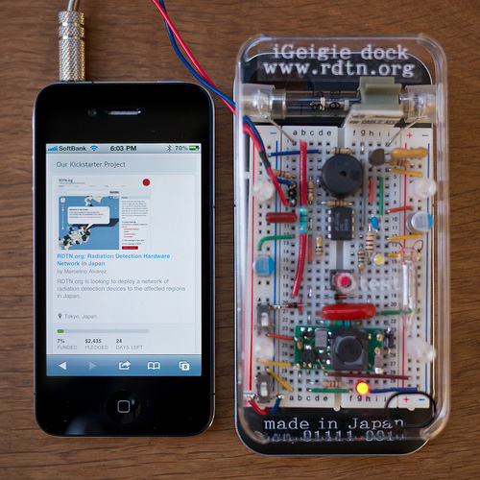
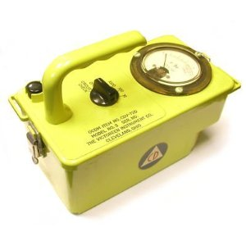
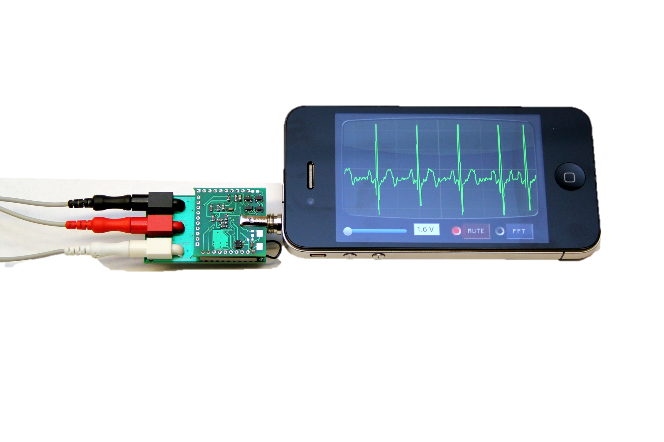
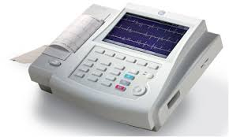
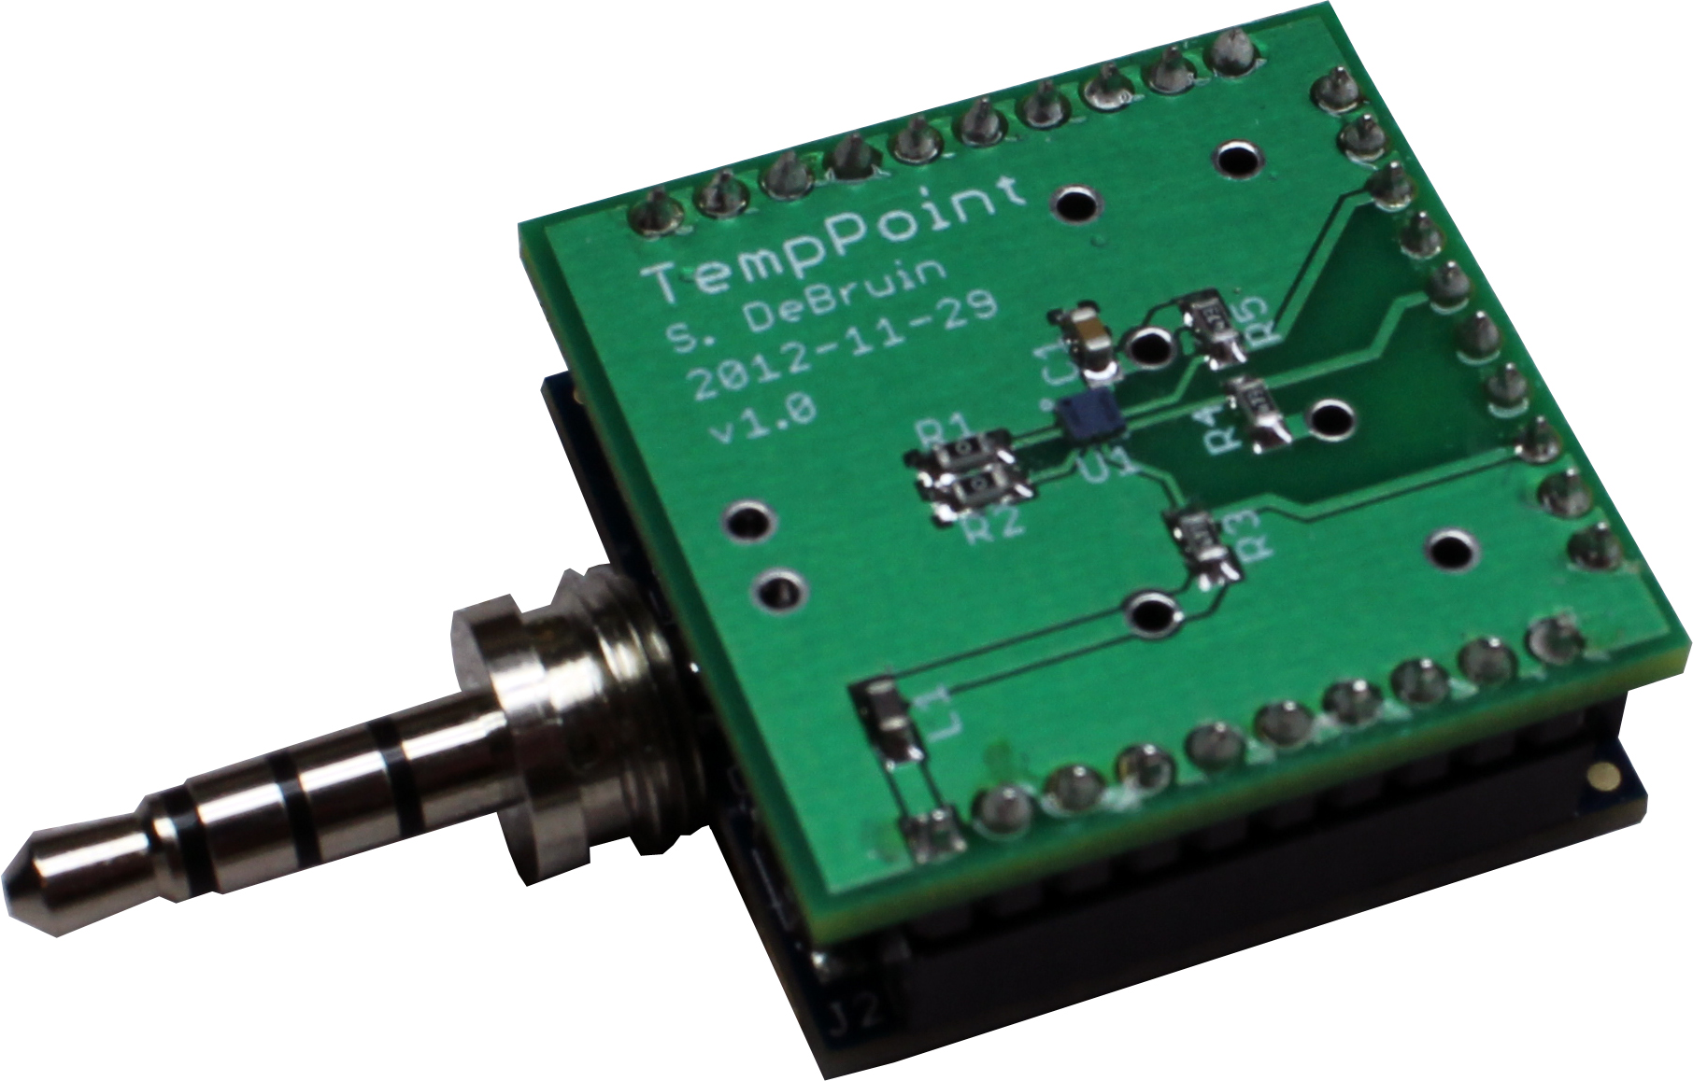
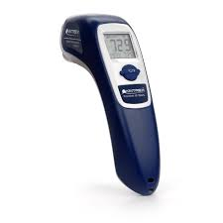
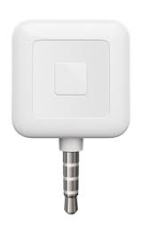
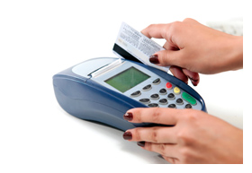
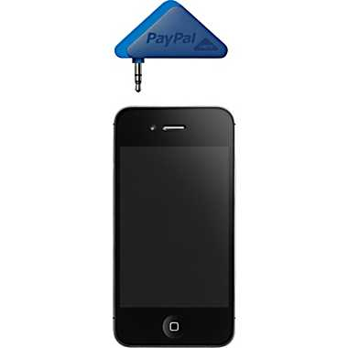
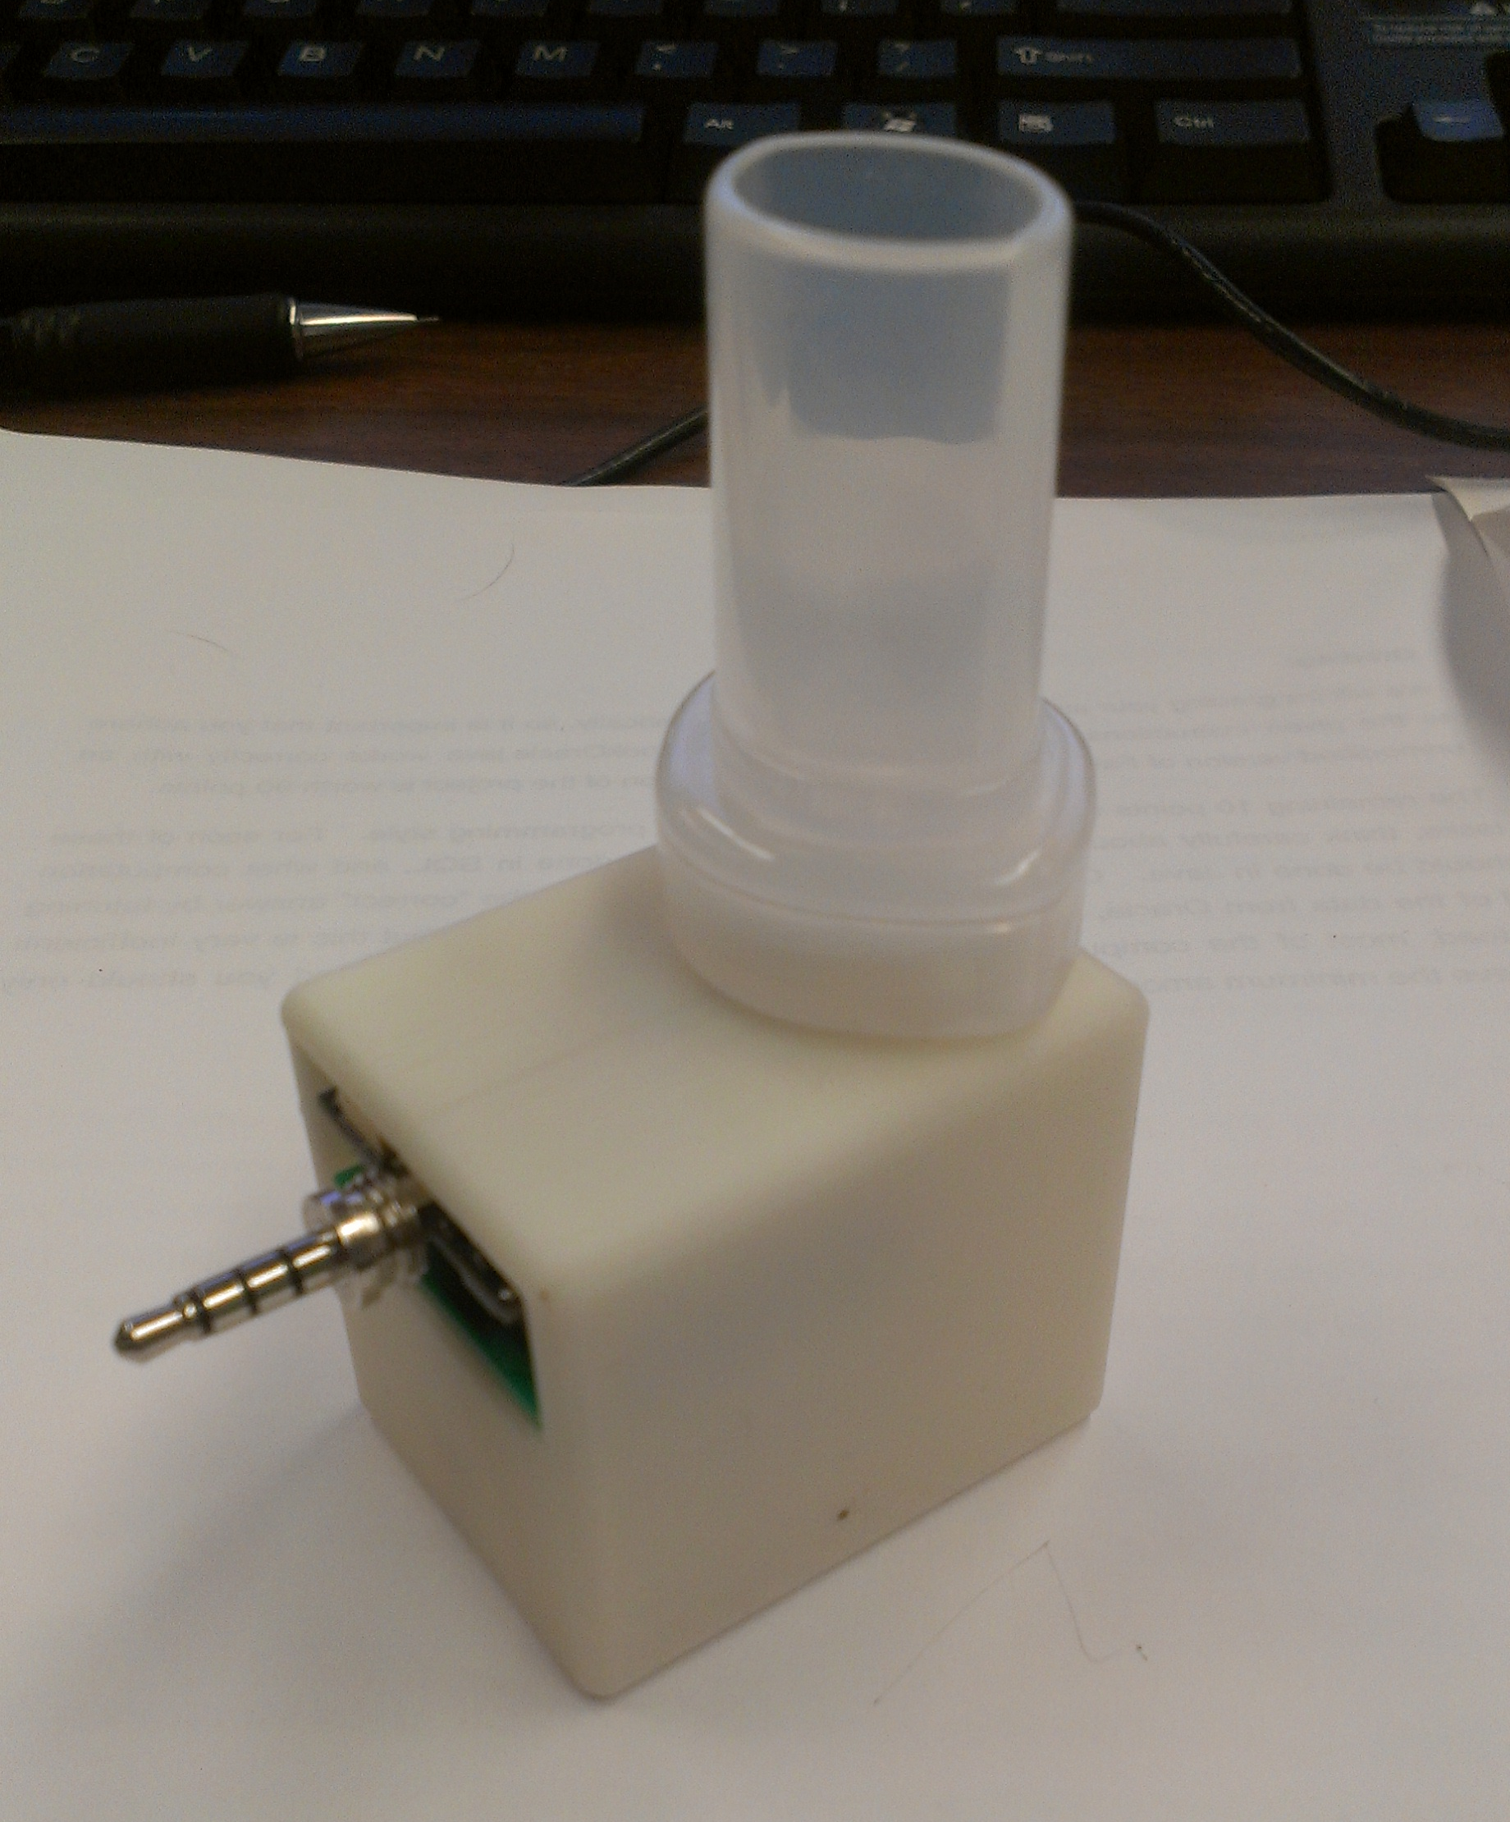






Augmenting smartphones to add “missing” sensors
Geiger Counter
EKG Monitor
Thermometer
CC Terminal
Soil Moisture
CO Sensor
[slide courtesy Prabal Dutta]

Slide 21
Takeaways
If you can think something to measure, it can be measured
Though measuring it directly may not always be the best approach
Constraints on data-collection define the rest of your system
Or at the least are a very good place to start
Smartphones are useful, but not a panacea
And can be costly (though re- and multi-purposeable)

Slide 22
Ask not what you can do for DIL, but what DIL can do for you
Problems, challenges, we need them!
What is interesting to collect?
What constraints aren’t we seeing?
Especially those that are developing world related

Slide 23


Cultural help: We like data too much for our own good
We can see devices turn on / off
Lose sight of the fact that humans are turning them on and off
Privacy implications
What should a system like this look like?
My roommate took ~16:30 in the bathroom this morning
Notes:
This is really neat!
We can see devices turn on / off
Lose sight of the fact that humans are turning them on and off
Privacy implications
What should a system like this look like?

Slide 24
It Gets Worse
We are affecting behavioral change often without concern for the consquences
iSleep example

Slide 25











I have lots of cool hardware with me today – come find me!
lab11.eecs.umich.edu
Prabal Dutta Advisor
Noah Klugman
GridWatch
Mobile Health
Ben Kempke
RF ranging
Radio design
Brad Campbell
Energy Harvesting
15.4, TinyOS
Meghan Clark
Smart Buildings
Disaggregation
Pat Pannuto
mm³ systems
VLC
{e,si}mulation
Branden Ghena
Gaze Tracking
Sam DeBruin
Energy Harvesting
AC Power Meters
Will Huang
Interaction Capture
“Opo”, Social Graph
YeSheng Kuo
µSDR
VLC, Floodcasting

